Slide 1
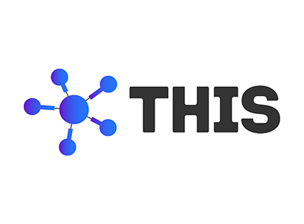
Project Presentation on
Train Ticket Reservation System

Slide 2
Presented by
Kirubavathi Kumar
Noah Fedrich
Shravan Kananthoor
Sujan G Bhargav

Slide 3
Problem statement
Build an application which should take train number and passenger details as input.
The application should generate a train ticket using the train details and passenger details.
Both the train and passenger details has to be stored in database.
The passenger's name, age, and gender should be accepted from the user.

Slide 4
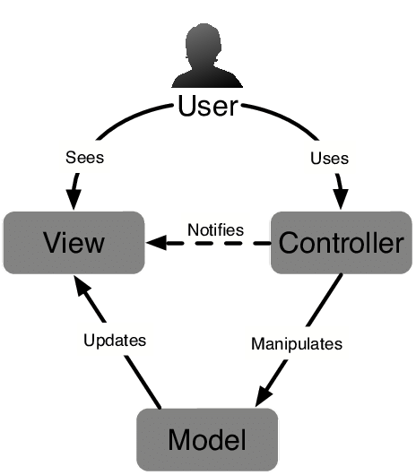
MVC Architecture

Slide 5
Software tools used
Spring tool suite(STS)
Mysql
Visual Studio Code
Postman/swagger

Slide 6
Front end UI
The front end is designed using Visual Studio Code.
The language here used is HTML.
Forms of passenger trains and tickets are created using VSC and they are made linked with each other.

Slide 7
API
API is developed using Spring tool suite(STS).
API for passenger trains and tickets are developed.
API is used to access data and server software (tomcat).

Slide 8
Back end (database)
Mysql is used as a database where the data is stored in the form of table.
Tables of passenger train and ticket are created with help of API.
The table will be updated with help of CRUD operations performed in UI

Slide 9
Future enhancement
Payment gateway
Bar code scanner

Slide 10
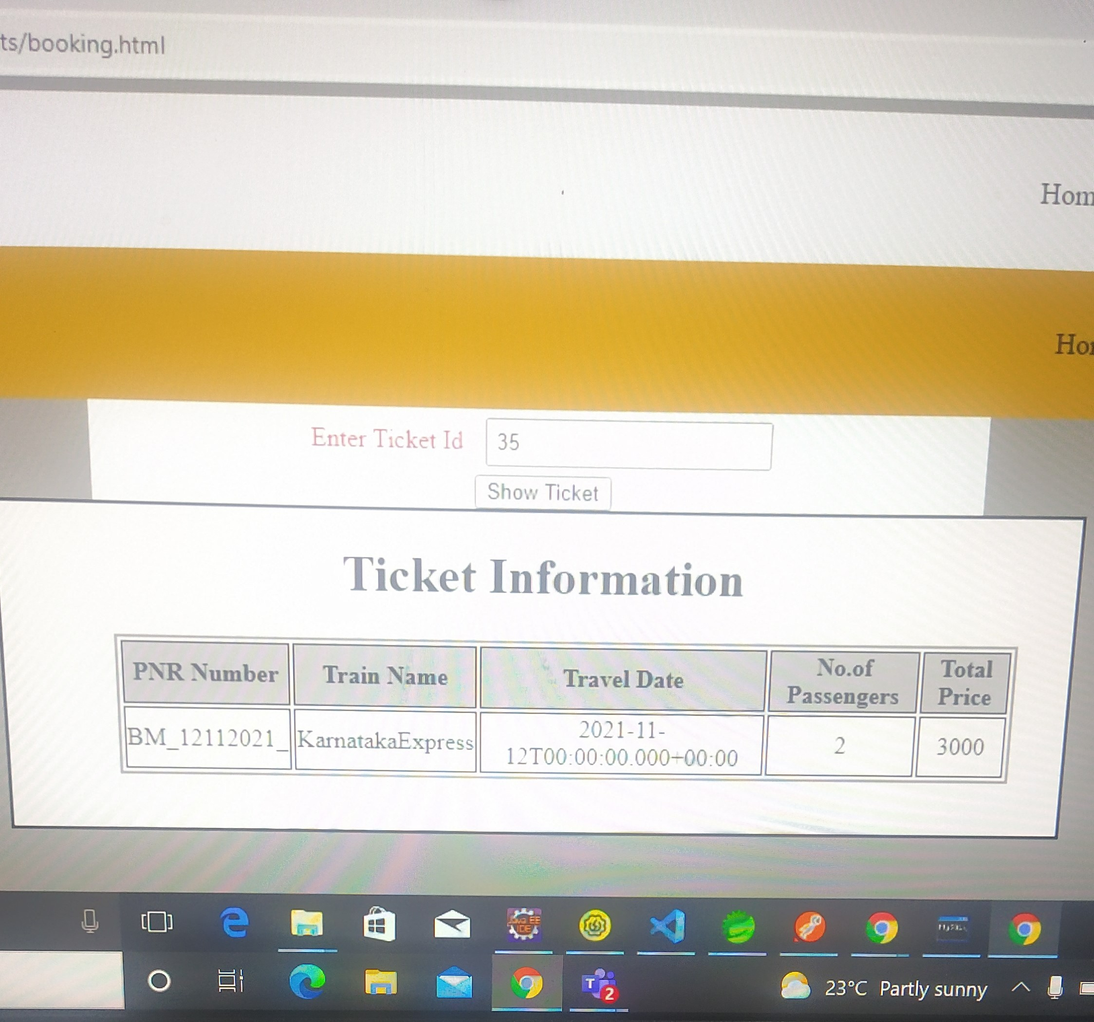
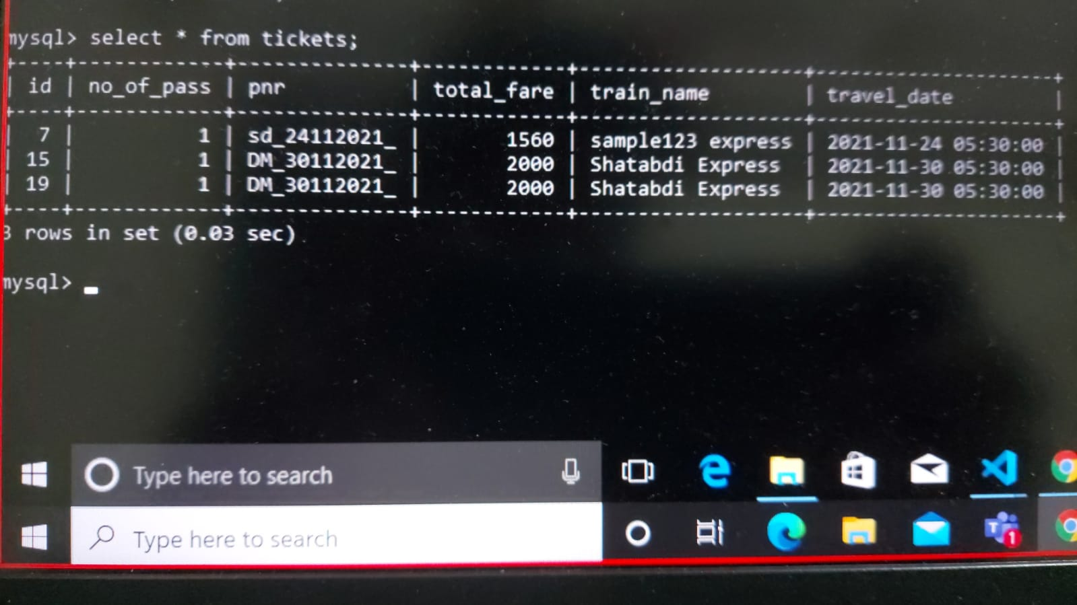
Front end
database

Slide 11
THANK YOU

